Slide 1


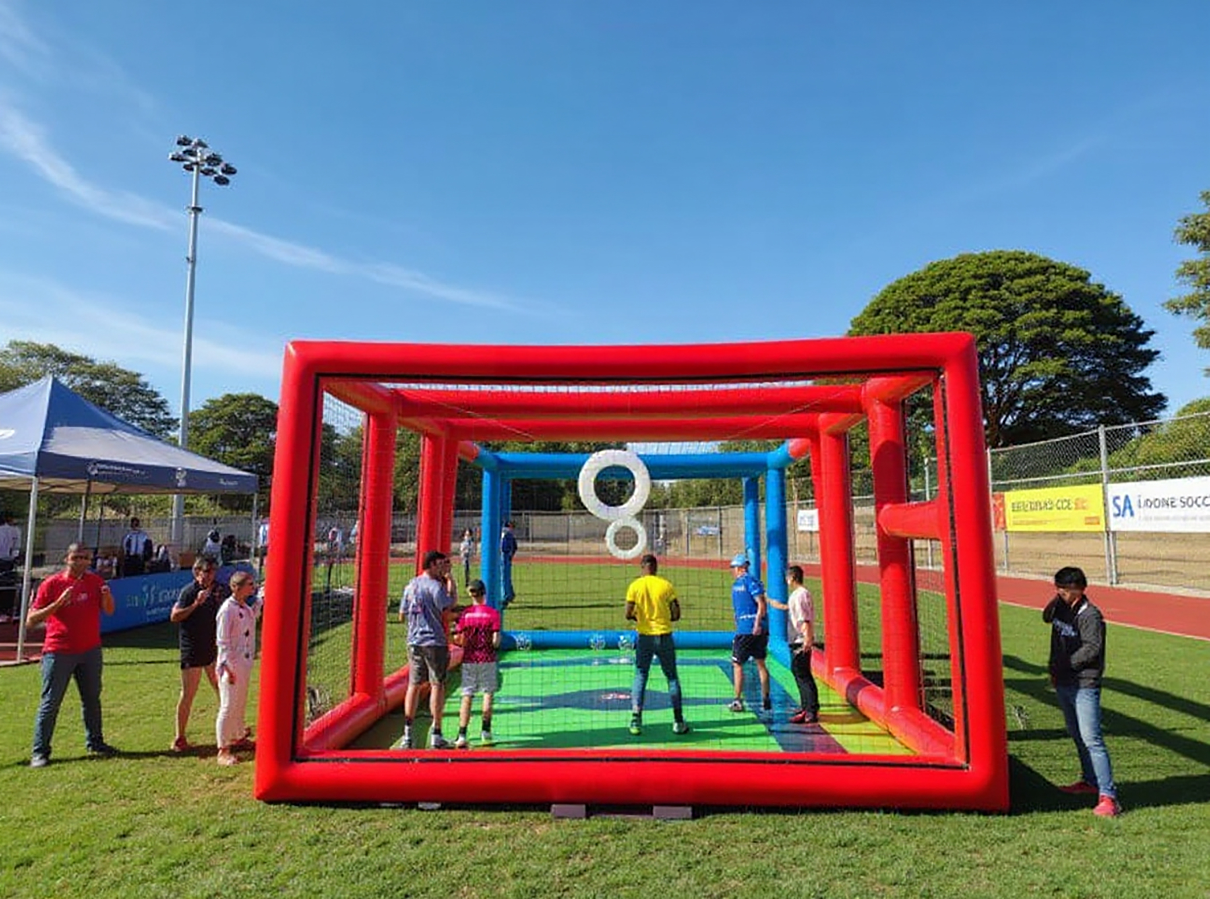
www.sadronesoccer.com
WELCOME TO
SA DRONE SOCCER
South Africa’s pioneering drone sport, empowering youth through STEAM education and competition.

Slide 2


About SA Drone Soccer?
SA Drone Soccer is an innovative educational programme that combines drone technology with the excitement of competitive sport. Learners pilot safe, enclosed drones in high-speed indoor soccer-style matches - building real-world STEAM (Science, Technology, Engineering, Arts, Maths) skills while having fun.
We use drone sport to engage students in a hands-on way, helping them gain experience in coding, physics, teamwork, spatial awareness, and problem-solving.

Slide 3

School
Tournaments
Boost STEAM learning with drone sport that teaches strategy, teamwork, and precision.
OUR PROGRAMMES
We offer structured programmes that bring drone-based learning into classrooms, communities, and training centres:
School Tournaments
Workshops & Training
Holiday Camps
Inter-school drone leagues that build teamwork, confidence, and STEM capabilities.
Interactive sessions on drone piloting, coding, maintenance, and safety.
Fun, immersive STEAM experiences during school breaks — learning through play.
Team Building
Team Building
Custom sessions for staff, teachers, and corporate teams to collaborate and connect.
Tailored initiatives aligned with ESD, CSI, and B-BBEE frameworks.

Slide 4


WHY DRONE SOCCER MATTERS
Tech-Powered Education for a New Generation
Drone Soccer brings the classroom to life. By making STEAM exciting, we help learners develop:
Future-ready digital and technical skills
Confidence in coding, robotics, and drone handling
Problem-solving and critical thinking
Collaboration and communication through team sport
It’s more than just a game.
It’s a gateway to the careers of tomorrow.

Slide 5

PARTNERSHIPS & SPONSORSHIP
Empowering Youth, Together
We collaborate with government, corporates, NGOs, and schools to deliver high-impact programmes nationwide.
Why Partner With Us?
Fully B-BBEE Compliant
Supports ESD & CSI scorecard elements
Scalable & measurable impact
Customised rollout models to suit your goals
Be part of building a future-focused education model. Fund a team, sponsor a school, or bring a league to your region.

Slide 6
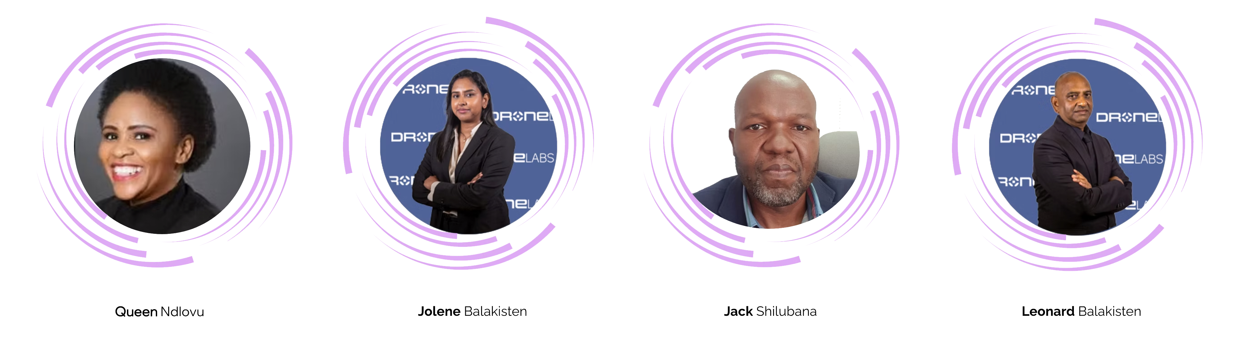
OUR MEETING TEAM
Queen Ndlovu

Slide 7
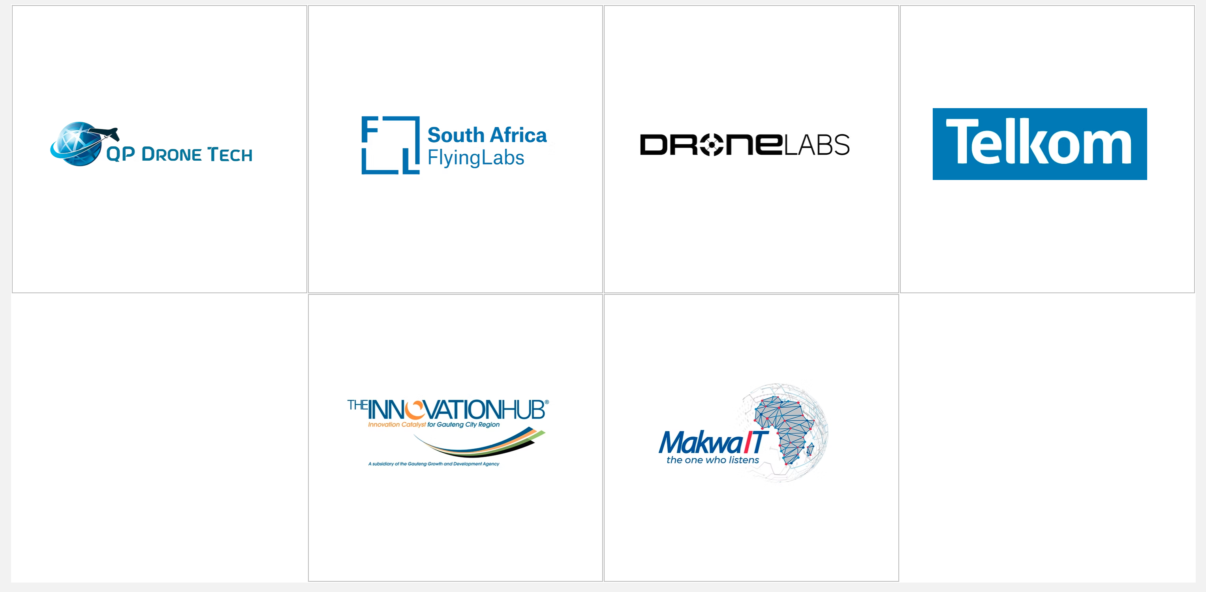
Sponsors and partners
Your Team

Slide 8
CONTACT US
SA Drone Soccer 📍 National Reach | 🇿🇦 Proudly South African
🌐 www.sadronesoccer.com
✉️ info@sadronesoccer.com
📞 +27 79 319 5385
Let’s launch the next generation of learners — one flight at a time.

